Slide 1
Dusty White Dwarfs and the Late Stages of Planetary Systems
Justin Ely

Slide 2
White Dwarf Observations
Dusty and Metal-enriched WD
~1% Dusty, excess emission in the IR
~25% Metal absorption lines in the UV
Elemental abundance consistent with terrestrial planets
Thought to be caused by tidally disrupted asteroids
Provides a probe of the surviving planetary system if the disrupting mechanism is understood

Slide 4
Inner Mean Motion Perturbation (IMMP)
Planetary systems with at least 1 dominant giant planet possess remnant asteroid belts
Libration width around resonance grows during mass loss
Over time these bodies are disrupted into star-crossing orbits

Slide 5
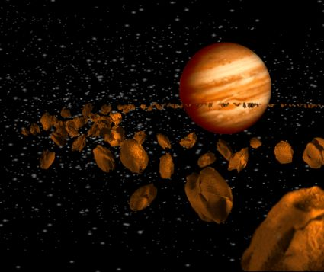
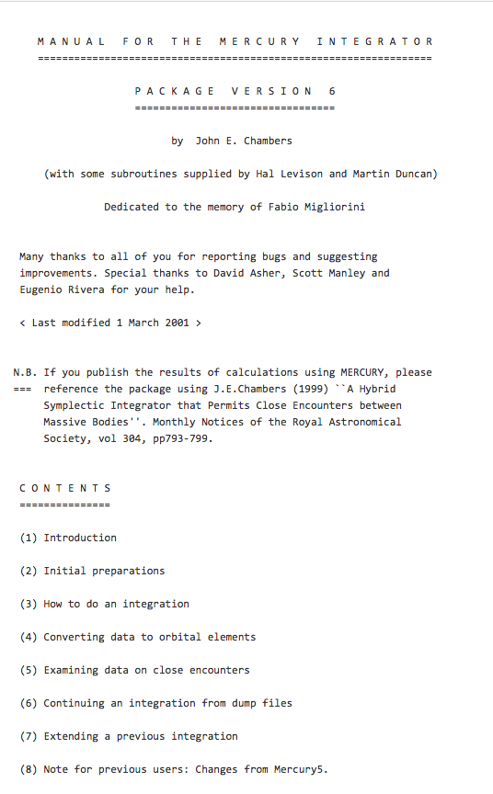
Simulation Parameters
Mercury6 Integration software
Central WD .54 Solar Mass
Masses of .1, 1, 10x Jupiter Mass
Semi-major axis of 1, 2, 3x Jupiter a
3x semi-major axis not able to begin due to lack of system resources
250Myr integration timescale
2000 bodies each

Slide 6
Asteroid Distributions
Design
Evenly sample the 2x libration width of the 2:1 resonance
Removes biases from initial condition
Permits convolution of trail distributions with even distribution to determine behavior without more integration
Sample asteroid belt distribution from Debes et al simulation

Slide 7
Tidal Disruption Results
Debes et al. tidal disruptions from simulations. 10,000 bodies, solar system distribution.
Low mass results in low efficiency at both semi-major axis
Jupiter mass most efficient perturber at either semi-major axis
Jupiter mass more efficient than 10x

Slide 8
References
Thanks to John Debes at STScI for the many enlightening conversations.
Debes, J., 2012, ApJ, 747, 148D
Chambers, J. E., 1999, MNRAS, 304, 793C
Koester, D., 2014, ApJ, 693, 805F

